Slide 1
INTERNSHIP
PROJECT REPORT ON
WEB DEVELOPMENT USING
“PYTHON PROGRAMMING”
BY, SHAIKH SHEERIN S.

Slide 2
HASMUKH GOSWAMI COLLEGE OF ENGINEERING
NAME : SHAIKH SHEERIN SAFDAHUSEN
COMPANY NAME : TOPS TECHNOLOGIES PVT.LTD
TECHNOLOGY : PYTHON PROGRAMMING
EXTERNAL GUIDE : MS. ANJALI PATEL

Slide 3
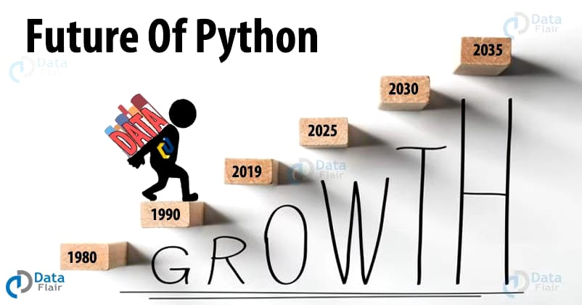
Python growth is promising in future – That’s Why I Choose Python
Python is the Future and it will serve as a huge, reliable, effective and ready-to-use technology.
What it can do for us? Well, it can play around with data, visualize the data, transform inputs into a numerical matrix, or actual machine learning and assessment.

Slide 4
Day 1 - Introduction To Python
What is Python ?
What is Software ?
Types of Software
What is Web Application ?
What is Mobile Application ?

Slide 5
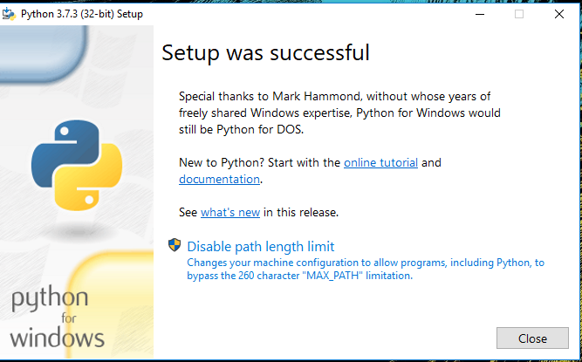
Day 2 - Installation of Python
To install Python, you need to download the official Python executable installer.
Next, you need to run this installer and complete the installation steps. Finally, you can configure the PATH variable to use python from the command line
Then Run the Executable Installer
After Installation you need to verify python from command prompt.

Slide 6
Day 3 – Looping and Conditions
Looping
Conditional Statements
while loops
for loop
With the while loop we can execute a set of statements as long as a condition is true.
With the for loop we can execute a set of statements, once for each item in a list, tuple, set etc.
1) if ....statement
2) if ....else condition
3) Elif statement

Slide 7
Day 4 & 5 – Functions, Strings
FUNCTION :
A function is a block of code which only runs when it is called.
You can pass data, known as parameters, into a function.
A function can return data as a result.
STRING :
Strings in python are surrounded by either single quotation marks, or double quotation marks.
'hello' is the same as "hello".

Slide 8
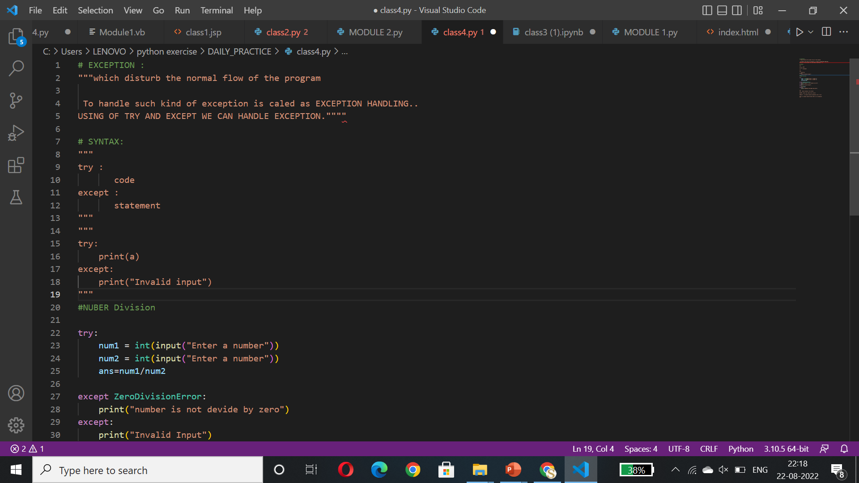
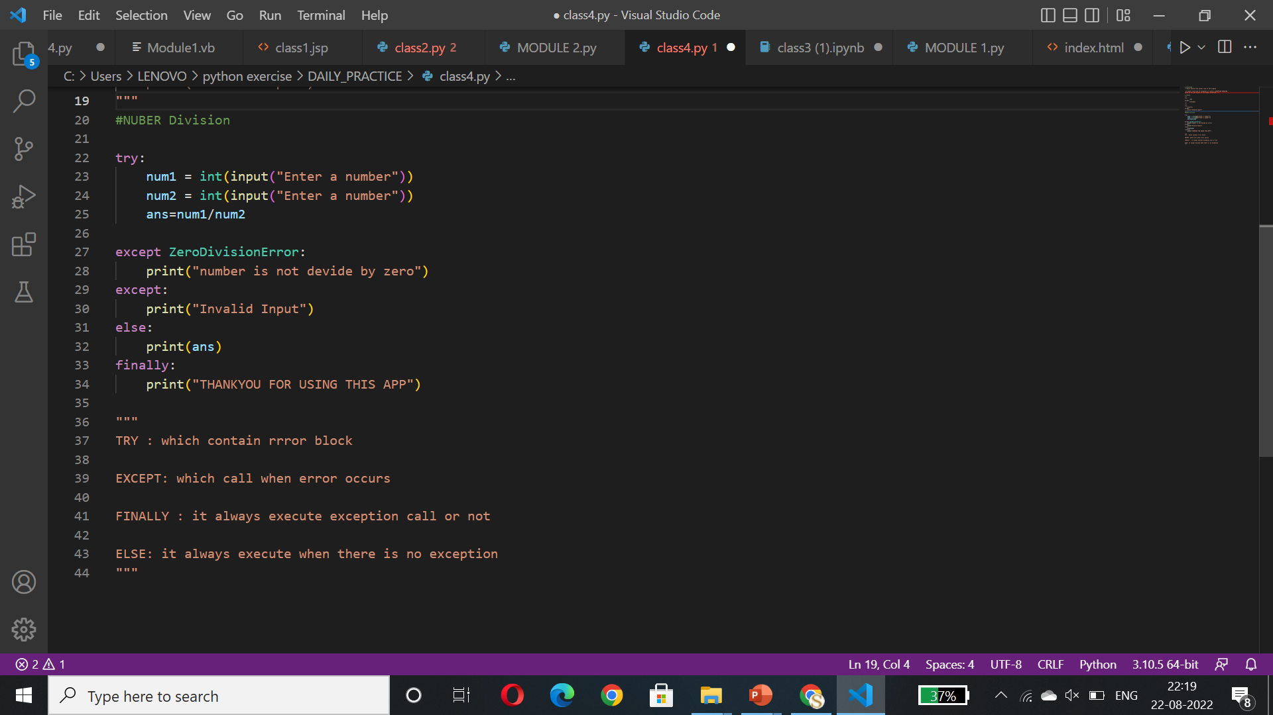
Day 6 & 7 – Exception Handling

Slide 9
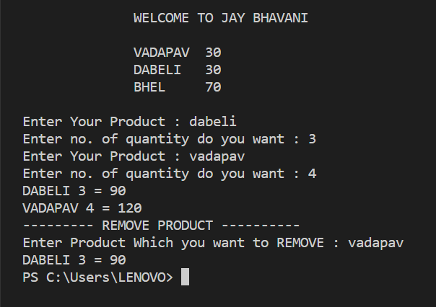
Day 8 & 9 – Fast Food Application
JAY – BHAVANI FAST FOOD TASK
In this task customer can choose items from menu and add the item and also customer can able to remove the item
And customer can also view bill details with price

Slide 10
Day 10 & 11 – Data Collections
LIST :
Lists are used to store multiple items in a single variable.
lists are defined by having values between square brackets [ ] .
TUPLE :
Tuples are used to store multiple items in a single variable.
A tuple is a collection which is ordered and unchangeable and Tuples are written with round brackets.
DICTIONARY :
Dictionaries are used to store data values in key : value pairs.
A dictionary is a collection which is ordered*, changeable and do not allow duplicates.

Slide 11
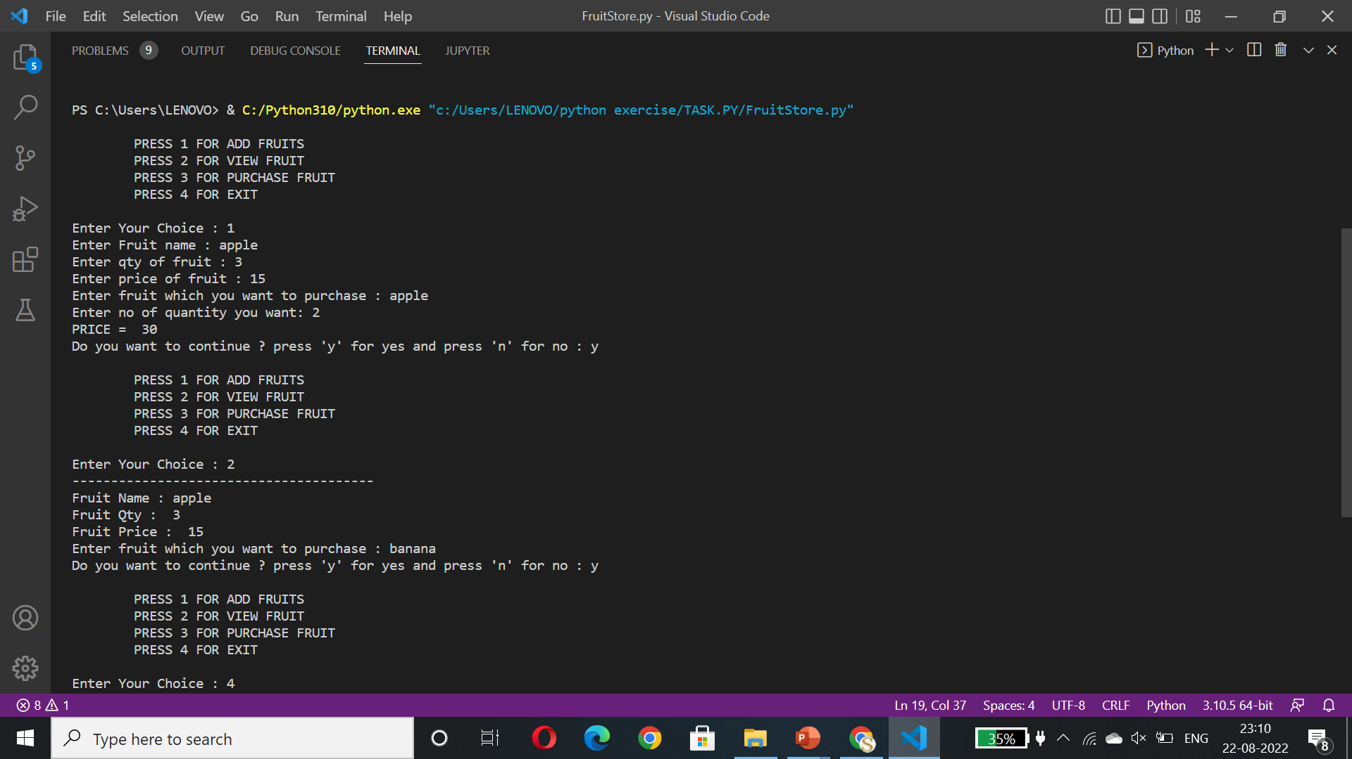
Day 12 – List & Dictionary Task
SIMPLE FRUIT STORE USING LIST AND DICTIONARY
In this application user can add and view as well as purchase fruit.

Slide 12
Day 13– OOP Concepts
class : is a collection of data member and member function which contains data member and member function in a single entity.
Object : is a variable of class. using of object we can access properties of class.
Encapsulation : data member and member function contain in single entity is called as encapsulation.
Abstraction : Abstraction in python is defined as a process of handling complexity by hiding unnecessary information from the user.
Inheritance : Object of one class can acquire data of another class

Slide 13
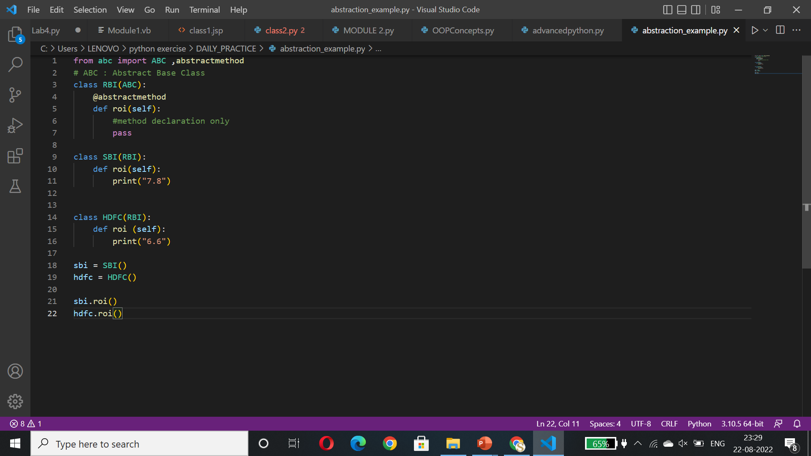
Day 14 – ABC (ABSTRACT BASE CLASS)
RATE OF INTEREST EXAMPLE
A class is called an Abstract class if it contains one or more abstract methods.
An abstract method is a method that is declared, but contains no implementation.
In the given example RBI contains abstract class whether SBI and HDFC are subclass .
RBI shows just main functionalities and does not contains other functionalities.

Slide 14
Day 15 – Student Management System App
In This task there are three main objects :
COUNCELLOR
FACULTY
STUDENT
COUNCELLOR can Add , Remove and View student and as well as he can view specific Student.
FACULTY can add marks of a student and he/she can view all student data.
STUDENT can view own details and pay fees

Slide 15
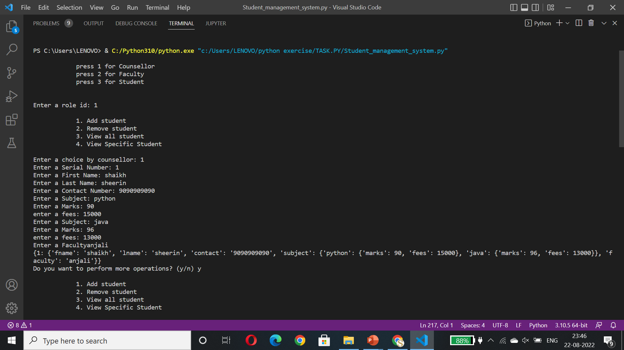

Slide 16
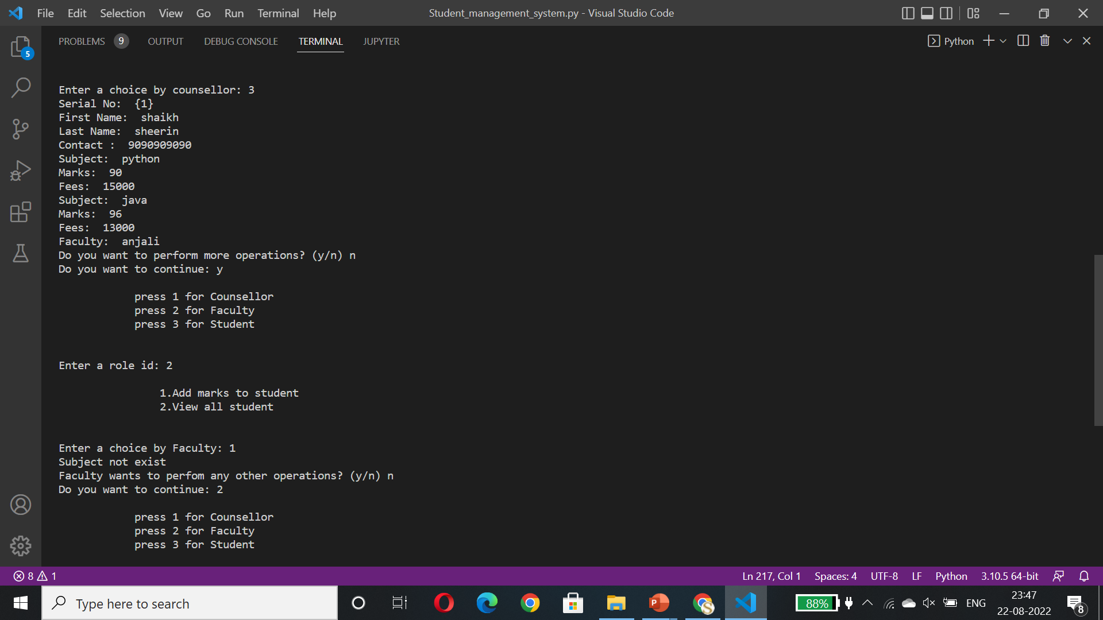

Slide 17
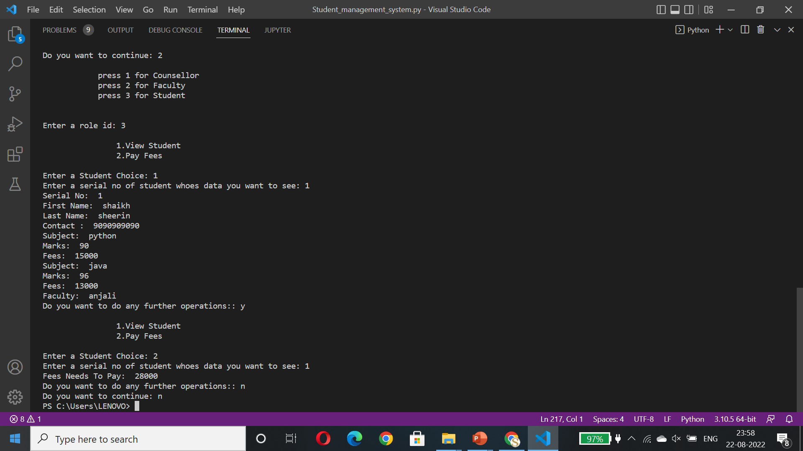

Slide 18
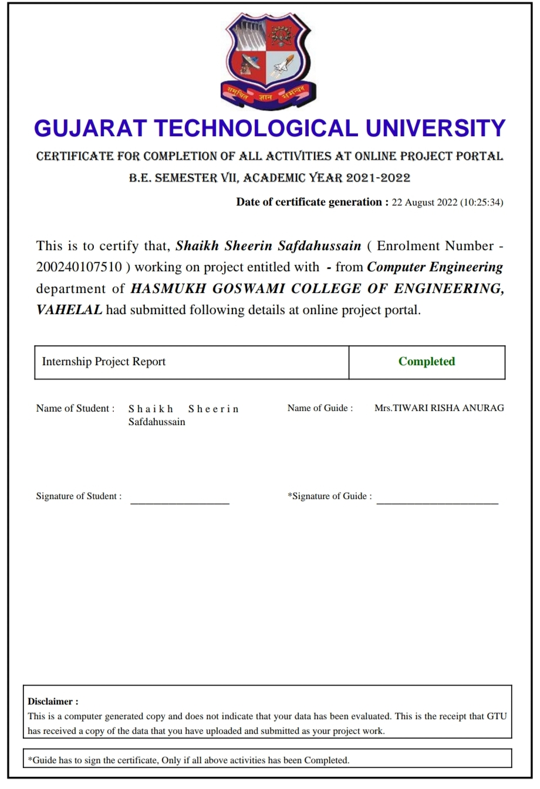
“Completion Certificate”

Slide 19
THANK YOU

